Slide 1
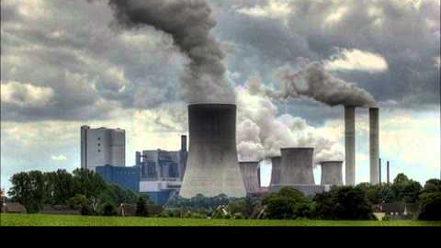
AQI Application to fight Climate Change

Slide 2
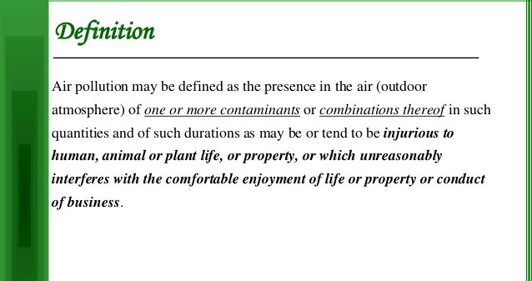

Slide 3
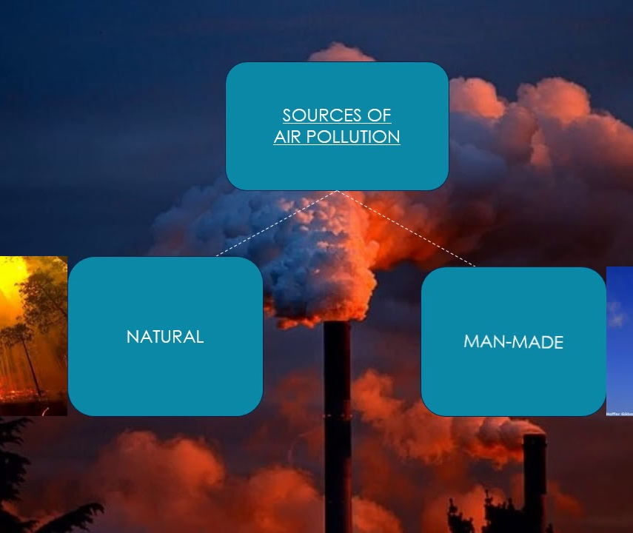
Sources of Air Pollution

Slide 4
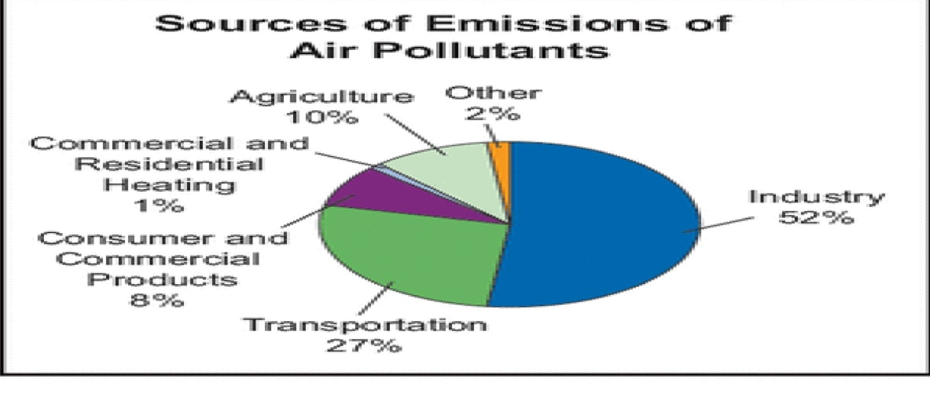

Slide 5
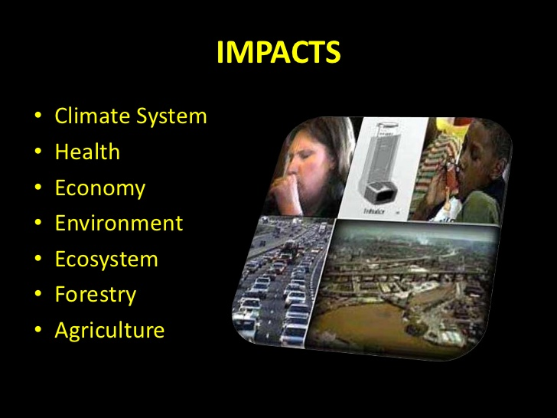

Slide 6
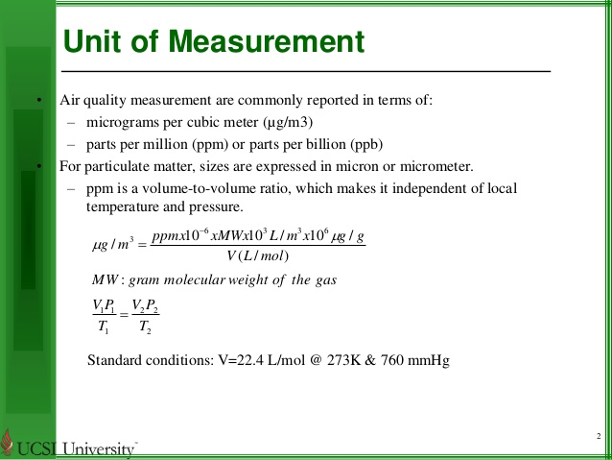

Slide 7
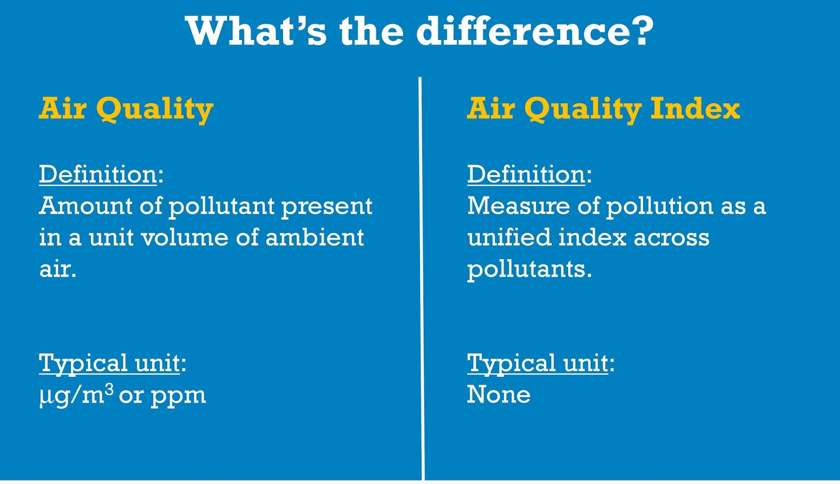

Slide 8
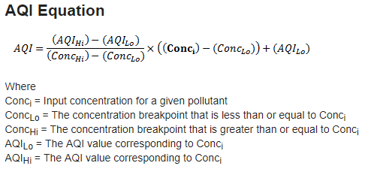

Slide 9
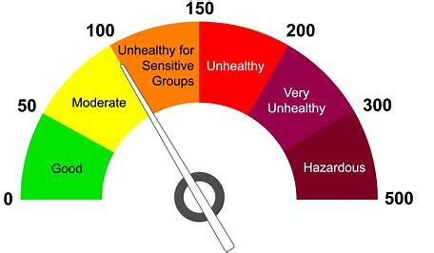

Slide 10
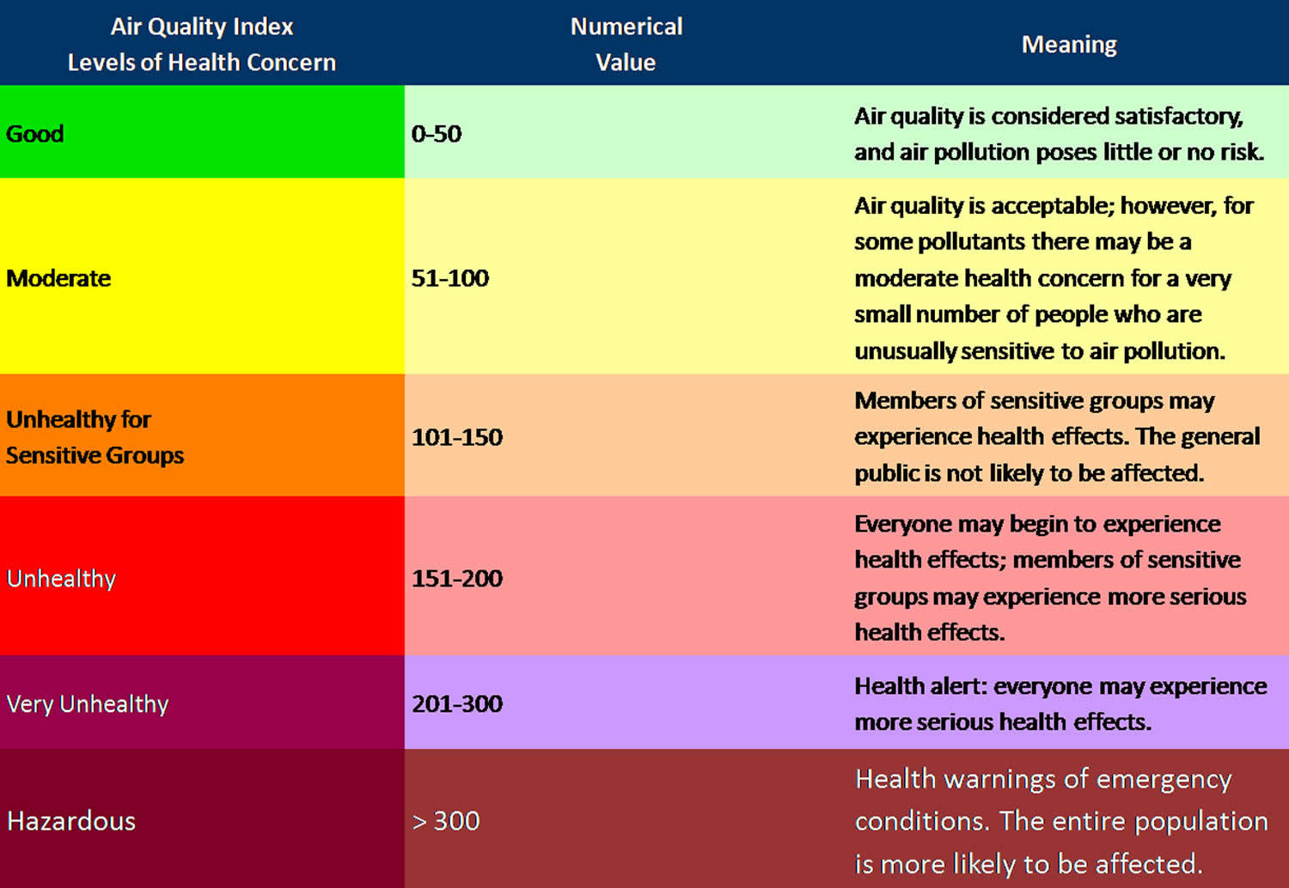

Slide 11
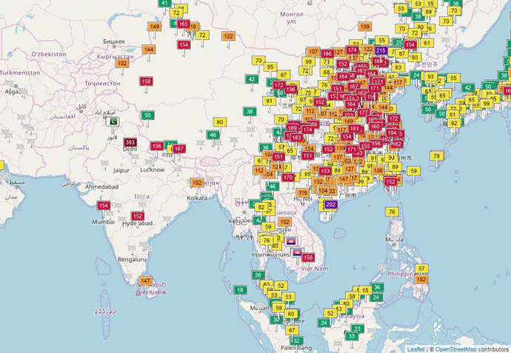
AQI Across different locations

Slide 12

Architecture of AQI Application
We will be having two portals in this application
Admin (Update the Required data to calculate AQI)
Users (Access the data from Different locations)

Slide 13
Technical Aspects
We use IBM Interface to Upload the data into Data base.
We create a Relational data base to access the data across multiple dimensions like city ,state and country as wells as for daily, monthly and yearly data.

Slide 14
Proposed Model
The Proposed model of the system is as follows. The block diagram of the system is showing that for a particular area selected how will it work. The device will be set up to take the environmental data and there will be a base standard value. The device will collect data and based on the set values it will show the output.
Area Select
Data Collection
Review, Evaluate and Action
Monitoring and Data Reporting

Slide 15
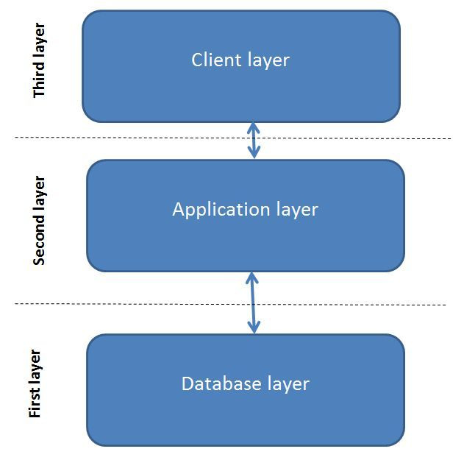
The 3 Layer Architecture
The Database layer: The layer which contains the normalized real data for different areas based on region or location user is currently looking at using IBM Cloud DB. This is written in SQL language that keeps connection with database.
The Application Layer: Takes initiative for implementation of the back-end codes which is mainly HTML and then .NET. Back-end programming is the structure of the webpage and is the core part of a webpage.
The Client Layer: It is about design portion of a web page where all the design works and layout of the page contains properly. Front end is all about user interface and what are visible to the user.

Slide 16
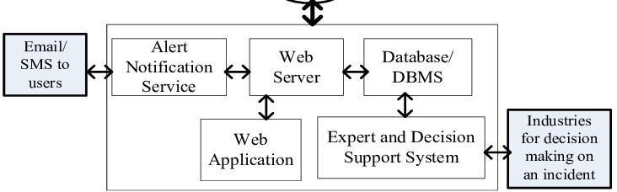
Real Data
The architectural model Of AQI Monitoring System

Slide 17
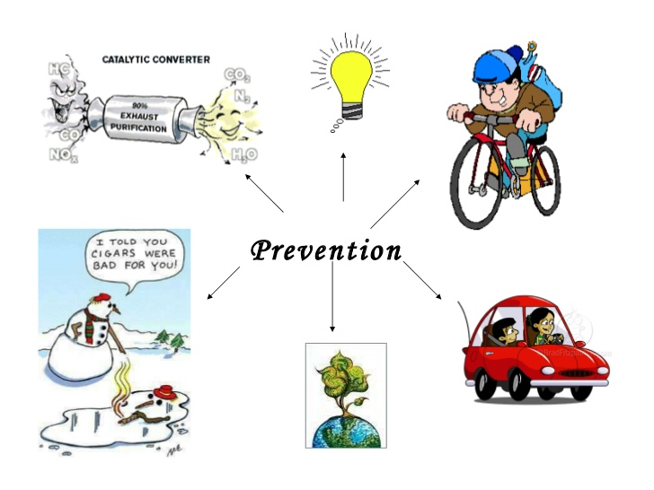

Slide 18
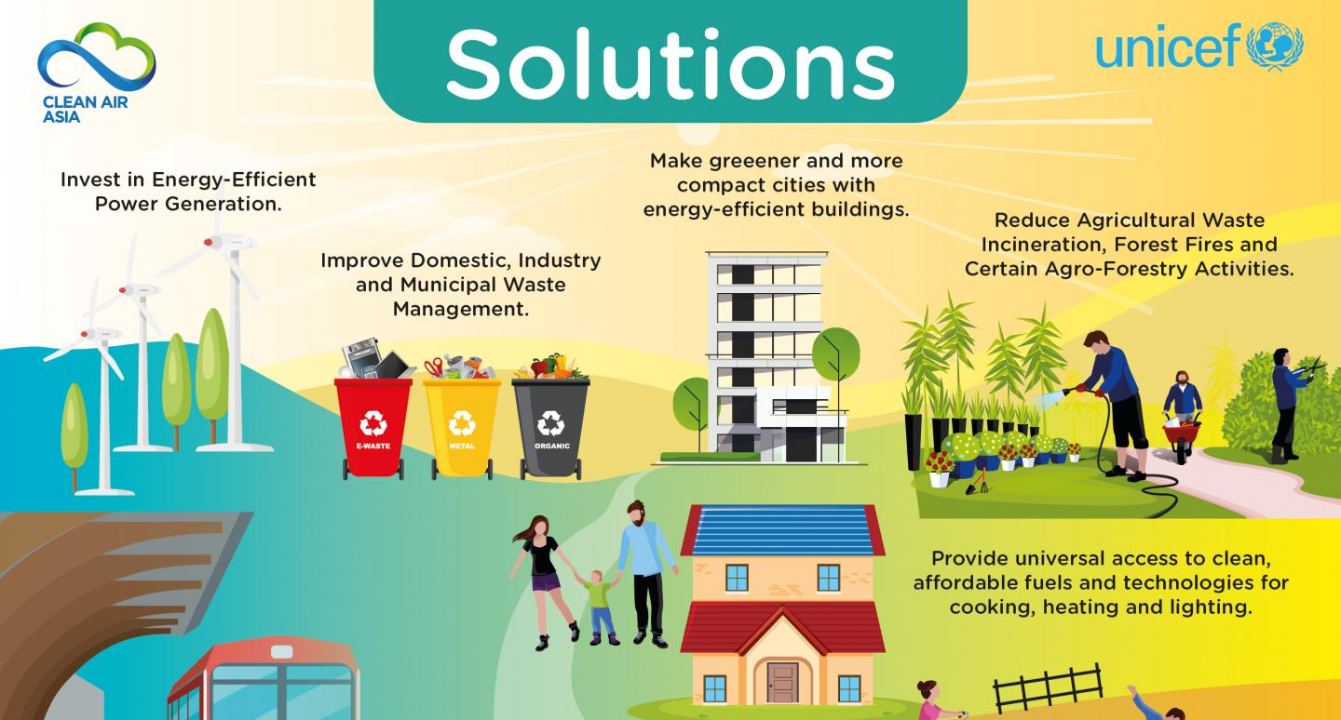

Slide 19

Thank You ☺

